Slide 1
Module c
Unit C1
Vocabulary
Language Functions
Speaking Activities
UTN FRVM Lic. Evangelina Cecchel - Lic. Bibiana Fernandez

Slide 2
Language Functions:
Describing processes
UTN FRVM Lic. Evangelina Cecchel - Lic. Bibiana Fernandez

Slide 3
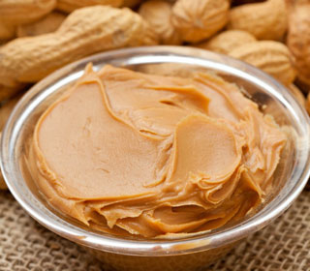
How peanut butter is made
UTN FRVM Lic. Evangelina Cecchel - Lic. Bibiana Fernandez

Slide 4
Vocabulary
Nouns Verbs
Peanuts harvest
Shells remove and discard
Peanuts roast
Peanuts cool
Peanuts blanch
Bacteria kill
Skins remove (in rubber rollers)
Peanuts grind
Salt, dextrose and oil add and mix
Mixture grind (second time)
Peanut butter produce
Peanut butter pack
Peanut butter sale
UTN FRVM Lic. Evangelina Cecchel - Lic. Bibiana Fernandez

Slide 5
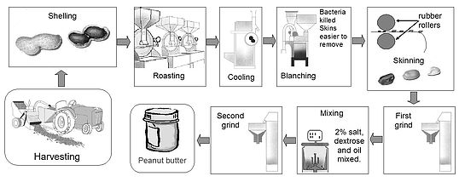
The diagram shows the process of making peanut butter from harvesting the peanuts to jars of peanut butter. Describe the process using Passive Voice when necessary.
UTN FRVM Lic. Evangelina Cecchel - Lic. Bibiana Fernandez

